Slide 1



safety form
View in Power BI
Last data refresh:
3/21/2022 12:12:16 AM UTC
Downloaded at:
3/23/2022 5:22:20 PM UTC

Slide 2
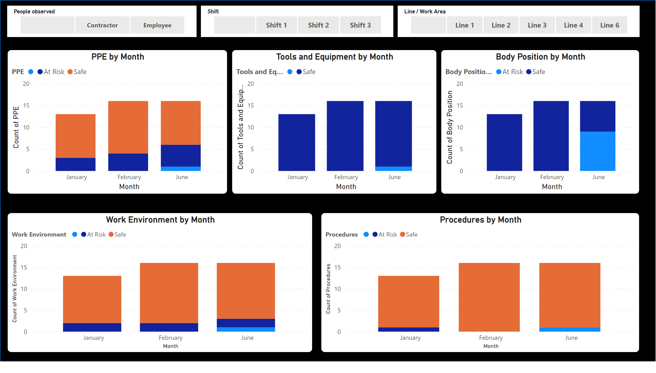
Page 1
Notes:
shape
No alt text provided
Procedures by Month
No alt text provided
PPE by Month
No alt text provided
slicer
No alt text provided
slicer
No alt text provided
Body Position by Month
No alt text provided
Tools and Equipment by Month
No alt text provided
Work Environment by Month
No alt text provided
slicer
No alt text provided

